Slide 1
Basics in programming

Slide 2
Python modules
Operator overloading
Suppose you have created a Vector class to represent two-dimensional vectors, what happens when you use the plus operator to add them?
You could, however, define the __add__ method in your class to perform vector addition and then the plus operator would behave as per expectation −

Slide 3
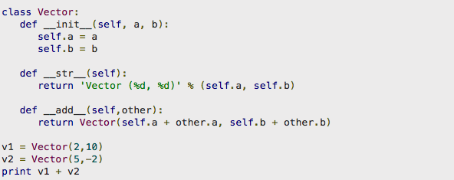
Python modules
Operator overloading

Slide 4
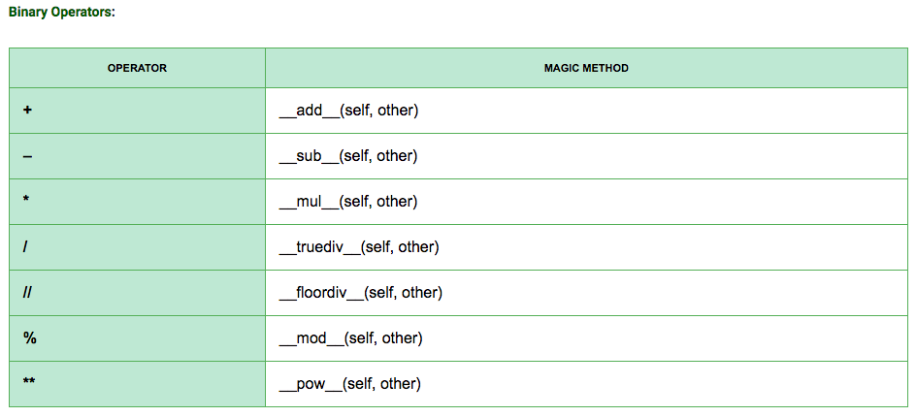
Python modules
Operator overloading

Slide 5
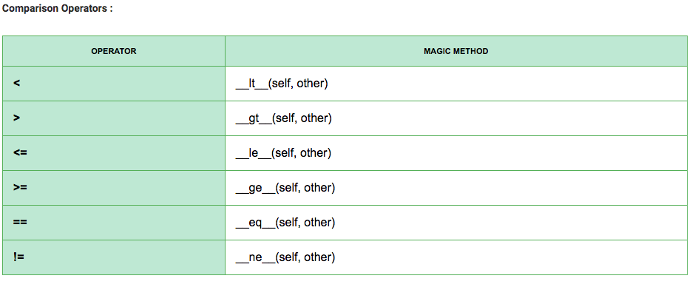
Python modules
Operator overloading

Slide 6
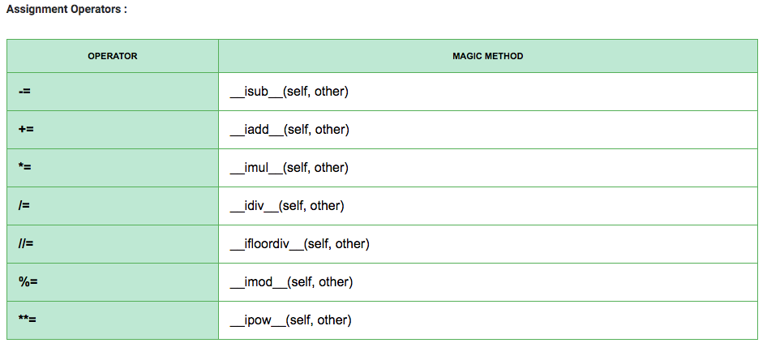
Python modules
Operator overloading

Slide 7
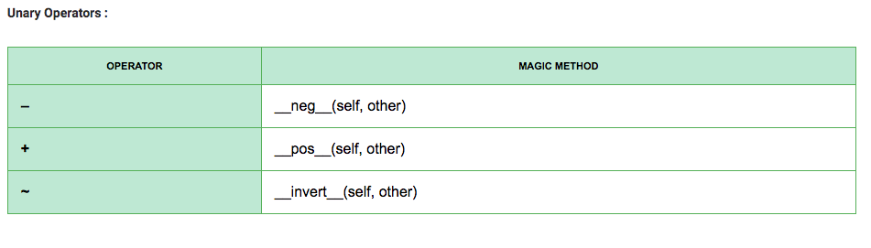
Python modules
Operator overloading

Slide 8
Python modules
Operator overloading
Example: implement subtract, multiplication and division of Vector

Slide 9
Python modules
Operator overloading
Example: implement subtract, multiplication and division of Vector

Slide 10
Python modules
Operator overloading
Example: implement subtract, multiplication and division of Vector

Slide 11
Python modules
Class attributes
A Python class attribute is an attribute of the class, rather than an attribute of an instance of a class.
This close to what Java and C++ call static variable of class.

Slide 12
Python modules
Class attributes
An instance attribute is a Python variable belonging to one, and only one, object. This variable is only accessible in the scope of this object and it is defined inside the constructor function, __init__(self,..) of the class.
A class attribute is a Python variable that belongs to a class rather than a particular object. It is shared between all the objects of this class and it is defined outside the constructor function, __init__(self,...), of the class.

Slide 13
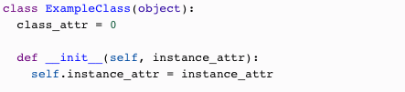
Python modules
Class attributes

Slide 14
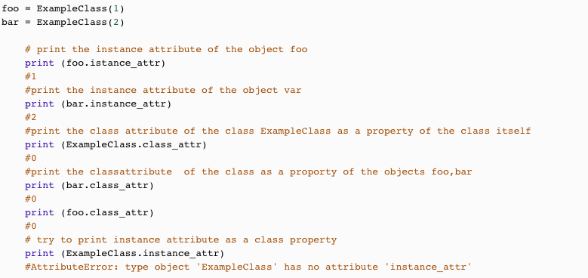
Python modules
Class attributes

Slide 15
Python modules
@property and getters/setters
In Python, getters and setters are not the same as those in other object-oriented programming languages. Basically, the main purpose of using getters and setters in object-oriented programs is to ensure data encapsulation.
Getters and Setters in python are often used when:
- We use getters & setters to add validation logic around getting and setting a value.
- To avoid direct access of a class field i.e. private variables cannot be accessed directly or modified by external user.

Slide 16
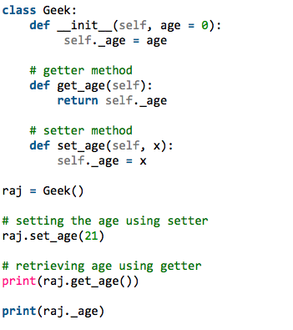
Python modules
Getters/setters
Consider our past learn way to get values from class instance

Slide 17
Python modules
Getters/setters
In Python property()is a built-in function that creates and returns a property object. A property object has three methods, getter(), setter(), and delete(). property()

Slide 18
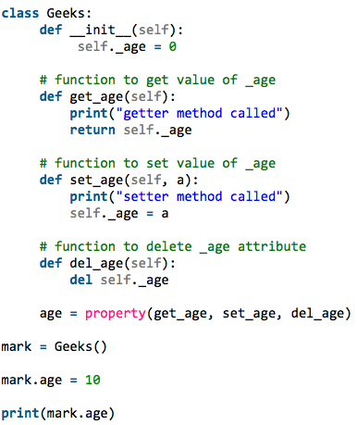
Python modules
Getters/setters
By using property we can
Define getters and setters

Slide 19
Python modules
Getters/setters
By using property we can
Define getters and setters

Slide 20
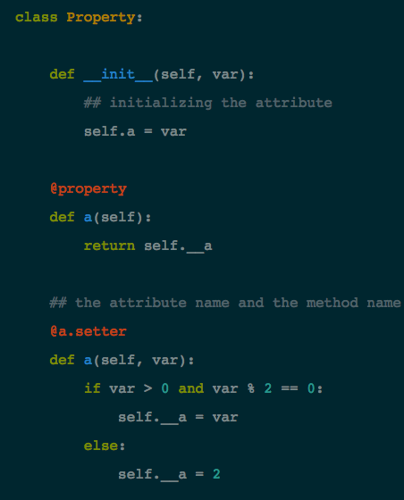
Python modules
@Property way
By using property we can
Define getters and setters

Slide 21
Exercies 14.
Create five instances of Human class so that each time instance of Human is created count in Mammal is increased by one.
Create new class called MonopolyMoney, then use operator overloading to make calculations with MonopolyMoney (add, substract, multiply and division)

